Slide 1
How to Play Energeo
Notes:
Setup instructions:
On the Admin computer that is projected, have this presentation in one tab.
On the second tab, go to https://gameblox.org/play/18134
Click the “Create new instance” button, choose “admin” and then click the submit button.
(if you see green monsters, redo this process)
Note the instance code on the admin computer.
On the four computers team computers go to https://gameblox.org/play/18104/
Type in the instance code (in all caps), then click the submit button
Choose the appropriate team

Slide 2

Your Goal: Keep Your People Healthy
Health
Notes:
In Energeo, you play members of a government. Everyone on your team represents the same government. Together, you are trying to meet your people’s needs in order to keep them healthy.

Slide 3

Good Health Requires Energy
Energy
Health
Notes:
In order to keep your people healthy, you need to produce energy! Sufficient energy makes lots of health related advancements possible: hospitals, refrigeration, water purification, safer heating. You’ll start out needing 5 energy, and each round, your people’s energy needs will increase as your country develops.

Slide 4

Energy Requires Power Plants
Power Plants
Energy
Health
Notes:
In order to produce the energy you need, you need to buy and use power plants. Some power plants are better than others; they produce more energy and/or produce less pollution. Pollution can lead to negative consequences for your country and other (pollution doesn’t stop at the border!)

Slide 5

Power Plants Require Partnerships
Partnerships
Power Plants
Energy
Health
Notes:
In order to buy power plants, you need to make partnerships with people from other government teams. You will do this by scanning codes on each other’s phones. Partnerships can be strengthened by meeting with the same person multiple times. So, to sum up: Everyone on your government team is working together to keep your country healthy. You will make partnerships with people from other governments, which you will trade in for power plants, which you will use to produce energy. If you produce enough energy, your people will be healthy - but watch out for pollution!

Slide 6




Time to form Delegations!
Notes:
[FACILITATOR NOTE: Break group into 4 delegations and hand out nametags & dossiers now. Each delegation should have 6-7 members. Have players put on their nametags so they know who they are.]

Slide 7
Download Links
iOS (iPhone/iPad)
http://tinyurl.com/gamebloxi
Android
http://tinyurl.com/gamebloxa
Notes:
Have the students install the Gameblox app on their devices. If their devices don’t work, give them an Amazon tablet

Slide 8
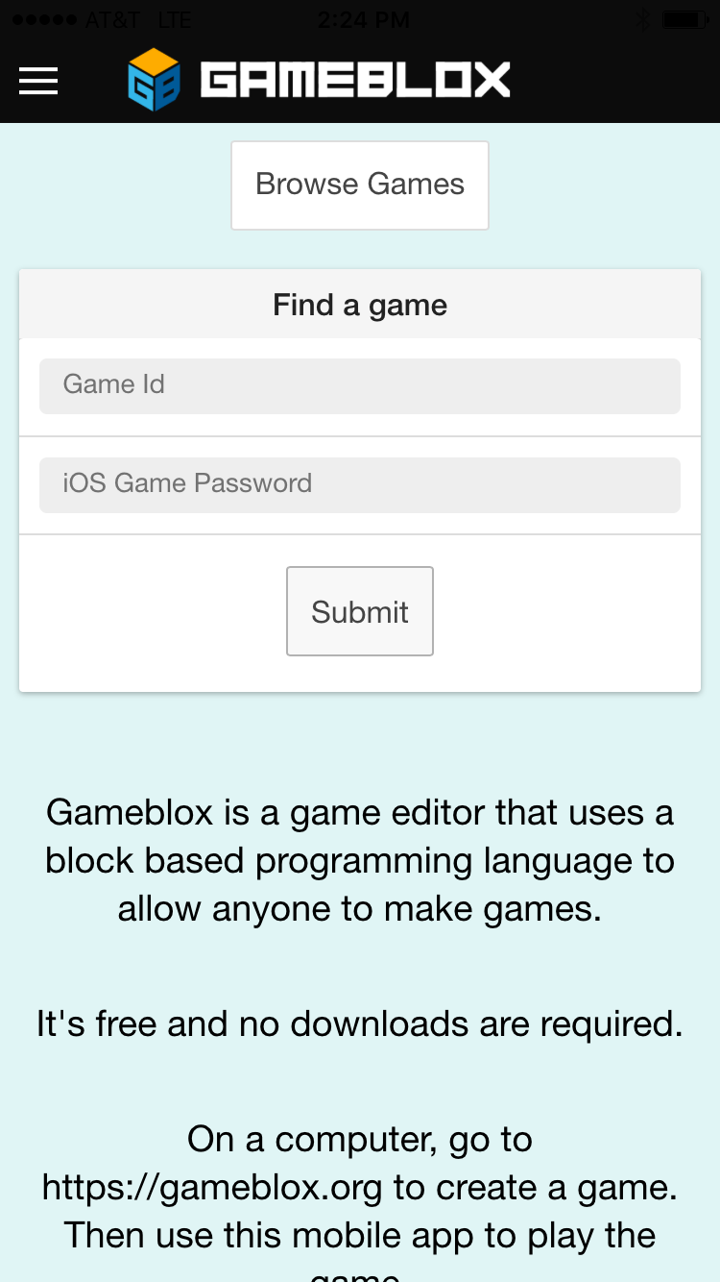
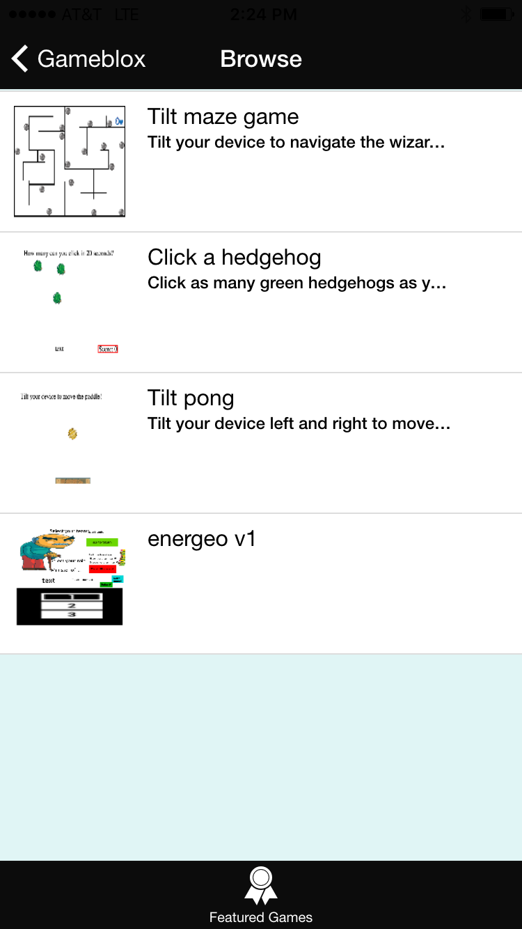
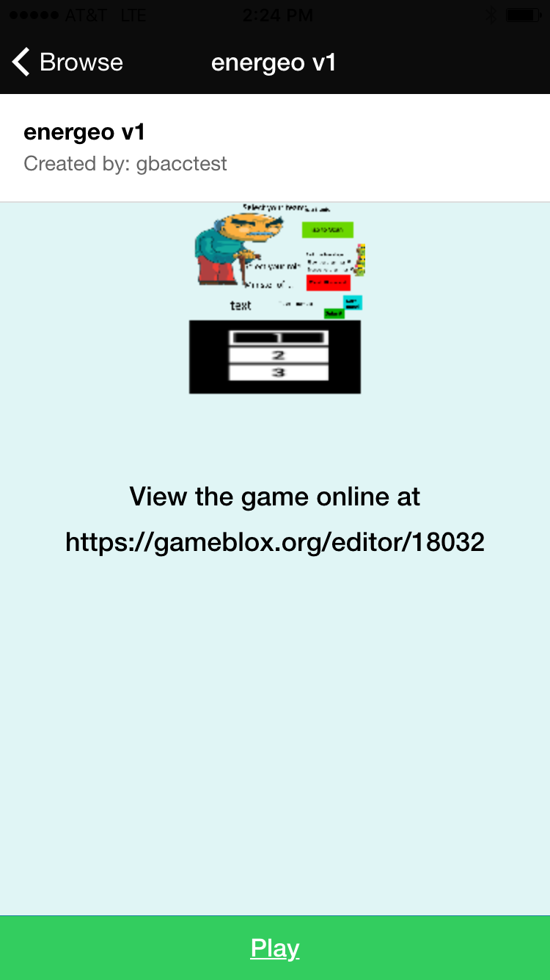
Setting up Energeo
Notes:
[FACILITATOR NOTE: Have players take these actions as you describe them] On your mobile device, open Gameblox and tap “Browse Games.” Then, select Energeo. Then tap “Play.”

Slide 9
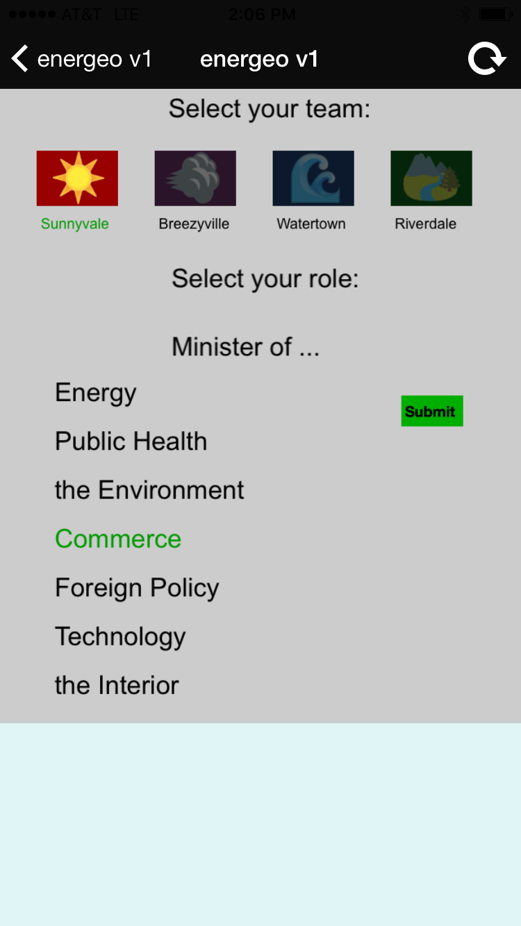
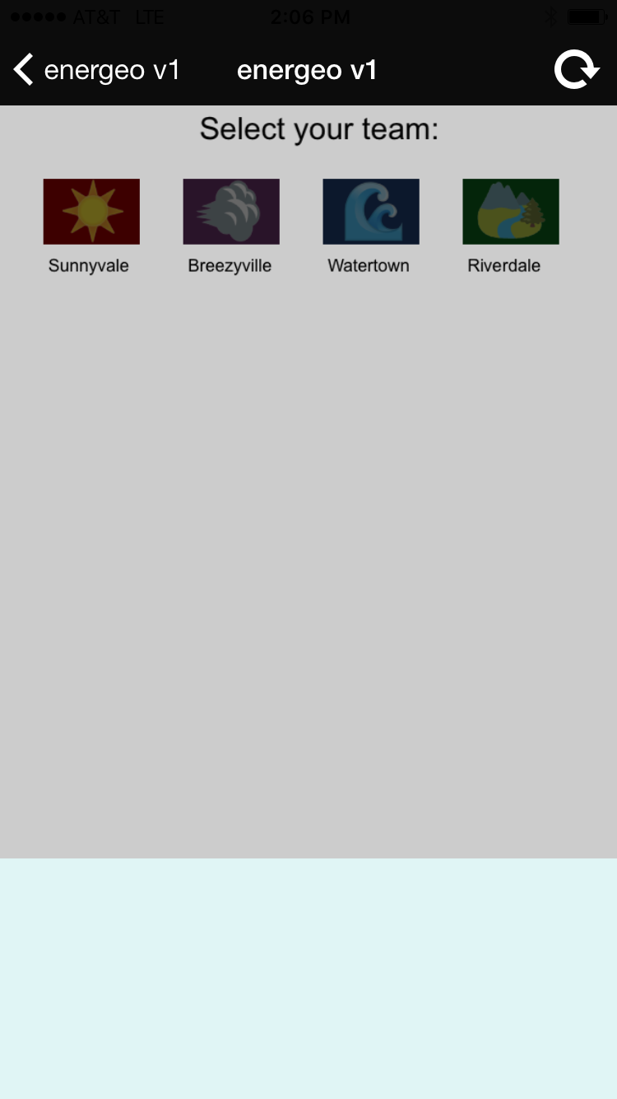
Setting up Energeo
Notes:
Select your team (the same one as is on your nametag). Select your role (the same one as on your nametag). Make sure you do not have duplicate roles within your team! Tap Submit.

Slide 10
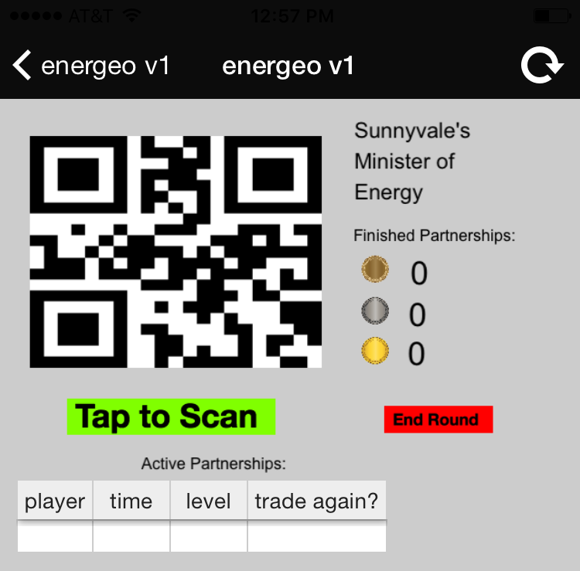
Scan to Make a Partnership
! BOTH PARTNERS MUST SCAN. SCANNING ONLY WORKS ONE WAY !
Notes:
[FACILITATOR NOTE: You will demo the scanning process at the front of the room with one other person - do not have the players scan each other’s phones at this time.] Everyone has QR codes on their phones. You want to go to someone from ANOTHER delegation and scan each other’s phones to make a partnership. You don’t make partnerships with your own delegation! It looks like this. [Demo the scanning process at the front of the room]

Slide 11
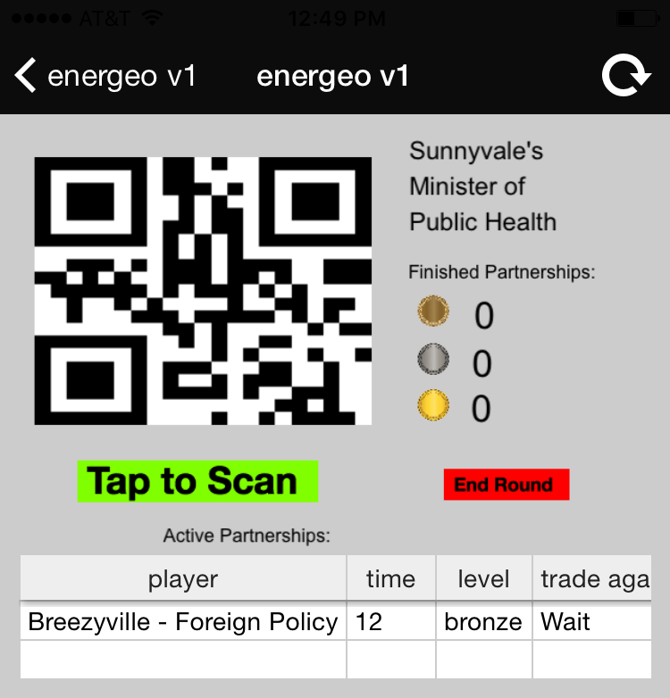
Scan to Make a Partnership
Notes:
In this example, the Sunnyvale Minister of Commerce has scanned the Breezyville Minister of Foreign Policy’s phone, and vice versa. They now have a Bronze level Partnership.

Slide 12

Re-Scan to Improve a Partnership
Notes:
After 30 seconds have passed, you can revisit a partner and scan again. See how in this example time passes, and the “Trade Again” notice goes from “Wait” to “NOW”? That means enough time has elapsed and you can scan again.

Slide 13

Re-Scan to Improve a Partnership
Notes:
In this example, the Sunnyvale minister scans their partner again. This upgrades their partnership from Bronze to Silver.

Slide 14
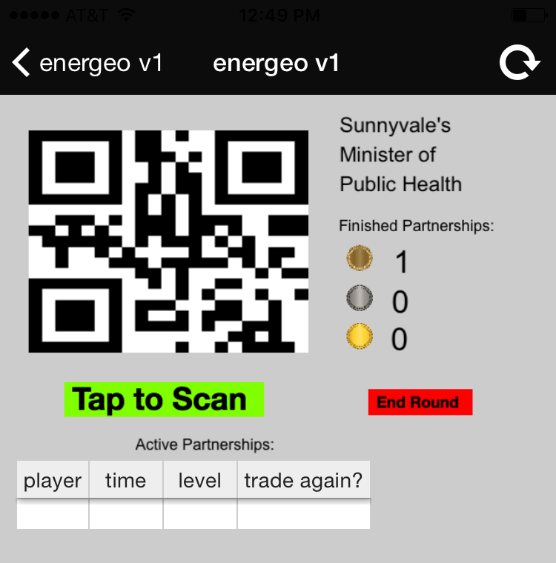
Letting a Partnership Time Out
Notes:
You only have a 30 second window where you are eligible to re-scan your partner’s phone. If you don’t scan during that window, the partnership times out and permanently becomes a bronze partnership. The partnership will disappear from your screen, but you still have it and can trade it in later. (You can go back and start the process over from the beginning if you want; there is no limit on how many partnerships you can make with one partner).

Slide 15
Notes
Don’t forget both partners must scan each other
Don’t accidentally hit the back button. All progress will be lost.

Slide 16
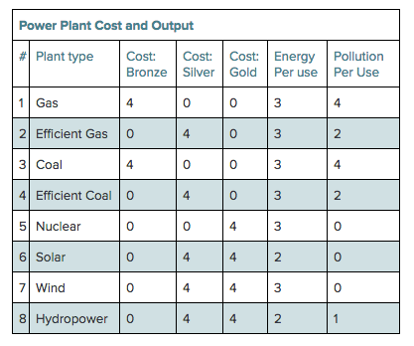
Go make partnerships - but plan ahead!
Notes:
[give them 2 min to read dossier/explain table] Play round one now! We’ll explain how to redeem your partnerships when you get back. You and your teammates may want to look at the chart on your dossier to see what kinds of partnerships you need for the power plants you want. [FACILITATOR NOTE: on the Admin Screen, which is projected at the front of the room, hit “NEXT PHASE” now. This starts the timer.]

Slide 17
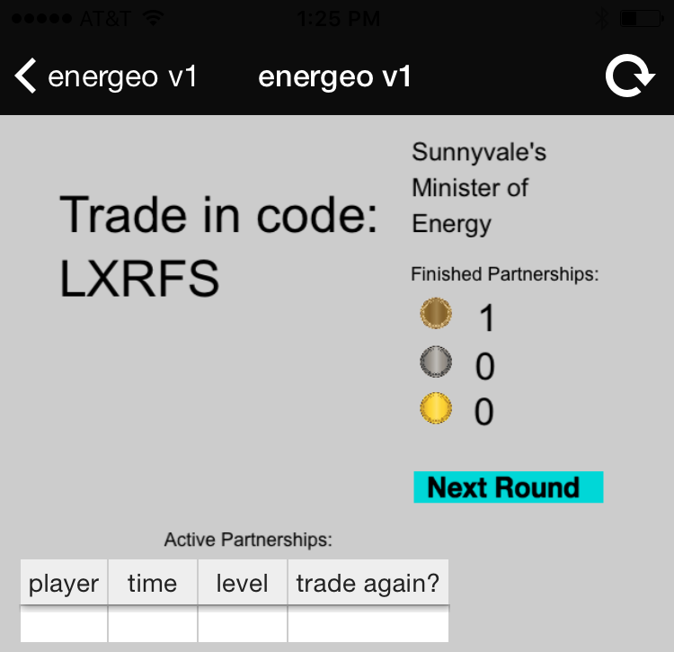
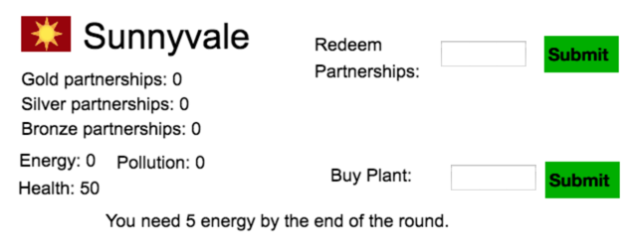
Trade In Partnerships
Notes:
Now that you’re done, each of you should enter the Trade In Code on your mobile device into the “redeem partnerships” box on your team computer.

Slide 18
Buy Power Plants
Notes:
To buy a power plant, enter the number of the plant (in the “#” column on the left side) into the Buy Plant field. Make sure you reach your energy goals or your health will suffer!

Slide 19
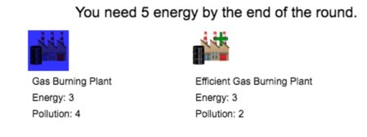
Use Power Plants
Notes:
Now that you have power plants, you can choose which ones you want to power. You should make sure that the plants you select generate at least 5 energy this round so that you have enough energy to power your nation. Click on the power plant to choose it, it will turn blue.
[FACILITATOR NOTE: After all of the teams have selected their plants, click the “Next Phase” button on the admin screen, which is projected at the front of the room. This updates the team scores. Once you are all done looking at the new team scores, hit the “Next Phase” button again. This takes you to the Advisory Report. When you’re done with that, hit “Next Phase” again to start the next round.]

Slide 20
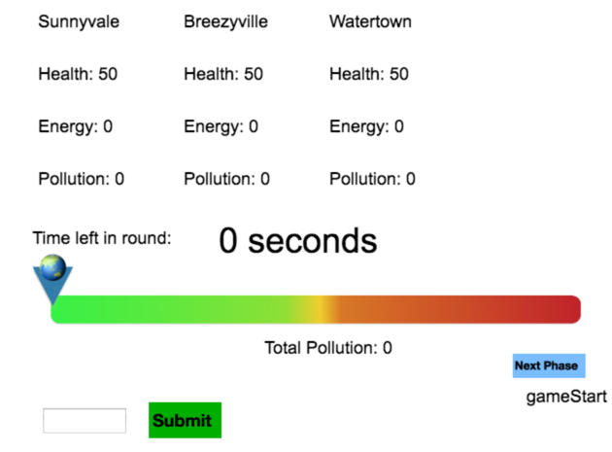
World Condition, Health and Pollution
Notes:
[Facilitator’s note: Transition to the World Condition screen, projected at the front of the room, to explain it] Now you how each delegation did. Did they meet their energy needs? You can also see the cumulative amount of pollution. What do we think that means?”

Slide 21
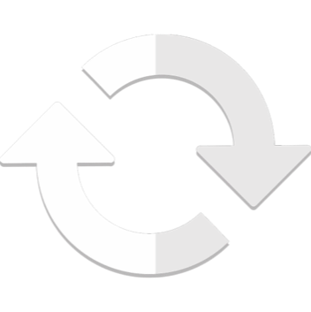
Repeat for two more Partnership Rounds

